Slide 1
STAT 5340 Statistical Analysis I
Introduction

Slide 2
In God we trust, all others bring data.
There are lies, damned lies, and statistics.
Statistics are like a string bikini, what they reveal can be
very interesting, but what they hide is often essential.
Observed
Data Value
Actual
Value
Measurement
Error
=
+
What we See, What is
“Revealed”, the “Lie”
What we Want to Know,
What is “Essential”
Nuisance, But Real
- Sampling Errors
- Bias Errors
- Measurement Approach
Variation Errors
- Blunders

Slide 3
Population is the group of individuals,
objects, or events that we want to
know something about
- All U.S. Citizens
- All Product from a Specific Manufacturing Line
- All Customer Complaints about a Specific Service
Population
Sample
Sample is a subset of the Population,
and is comprised of the individuals,
objects, or events we can observe
- A poll of U.S. Citizens
- Product from a Specific Lot
- Complaints from a Specific Time Period
Variable is a Characteristic of Interest,
Generally can be Measured for any
Item in the Population or Sample
- Voting Preference/Intent
- A Specific Quality Characteristic (eg, Size, Strength, etc)
- Specific Nature of a Complaint
Types of Variables | Other Descriptors | Additional Breakdown | Examples
Qualitative | Attribute, Categorical | Nominal (No Inherent Order) | Demographic - Race, Gender, Religion, etc
 |  |  | Political Affiliations, Job Types, etc
 |  | Ordinal (Inherent Order) | Non-numerical Ratings (eg, Good, OK, Bad)
 |  |  | Age Groupings (eg, Under 21, 21-40, Over 40)
Quantitative | Numerical | Discrete (Finite Number of Possible Results) | Counts (eg, Particles, Defects, etc)
 |  |  | Numerical Ratings (eg, 1 to 10 integers only)
 |  | Continuous (Theoretically Infinite Results Possible) | Measured Values (eg, Distance, Weight, etc)
 |  |  | Time
More Information is Carried in the
Data as we go Down the Table, So
“Best” Data is Quantitative, Continuous,
Which is the Type we will Use Most

Slide 4
Variable is a Characteristic of Interest,
Generally can be Measured for any
Item in the Population or Sample
- Voting Preference/Intent
- A Specific Quality Characteristic (eg, Size, Strength, etc)
- Specific Nature of a Complaint
Population
Data Value is a quantity or description
associated with a specific Variable for
One element of the Population or Sample
- Democrat
- 0.011 microns
- Lost luggage
Sample
Data is the group of Data Values for a specific
Variable for the items in the Sample
Generic | Party | Microns | Complaint
x₁ | Democrat | 0.014 | Poor In-Flight Service
x₂ | Republican | 0.015 | Late Flight
x₃ | Republican | 0.006 | Late Flight
x₄ | Democrat | 0.012 | Late Flight

Slide 5
Data is the group of Data Values for a specific
Variable for the items in the Sample
Generic | Party | Microns | Complaint
x₁ | Democrat | 0.014 | Poor In-Flight Service
x₂ | Republican | 0.015 | Late Flight
x₃ | Republican | 0.006 | Late Flight
x₄ | Democrat | 0.012 | Late Flight
x₅ | Other | 0.010 | Late Flight
x₆ | Republican | 0.007 | Late Flight
x₇ | Republican | 0.015 | Late Flight
x₈ | Democrat | 0.003 | Poor In-Flight Service
x₉ | Democrat | 0.014 | Late Flight
x₁₀ | Democrat | 0.006 | Late Flight
x₁₁ | Democrat | 0.014 | Lost Luggage
x₁₂ | Republican | 0.014 | Lost Luggage
x₁₃ | Democrat | 0.010 | Lost Luggage
x₁₄ | Democrat | 0.016 | Poor In-Flight Service
x₁₅ | Democrat | 0.012 | Poor In-Flight Service
x₁₆ | Democrat | 0.015 | Late Flight
x₁₇ | Democrat | 0.014 | Late Flight
x₁₈ | Democrat | 0.012 | Other
x₁₉ | Republican | 0.015 | Late Flight
x₂₀ | Democrat | 0.011 | Late Flight
Population
Sample
Statistic is a numerical value summarizing the Sample Data
Party | Number | Percent
Democrat | 13 | 65.0%
Republican | 6 | 30.0%
Other | 1 | 5.0%
All | 20 | 100.0%
Complaint | Number | Percent
Late Flight | 12 | 60.0%
Lost Luggage | 3 | 15.0%
Poor In-Flight Service | 4 | 20.0%
Other | 1 | 5.0%
All | 20 | 100.0%
Statistic | Microns
Average | 0.0118
Std Dev | 0.0037
But Are the Statistics
What we Want to Know?

Slide 6

Statistic is a numerical value summarizing the Sample Data
Parameter is a corresponding numerical value
summarizing the Population Data
Population
Parameters are generally what we want to know,
But Statistics are all we generally have available
Sample Statistics
Population Parameters
Sample
Party | Number | Percent
Democrat | 13 | 65.0%
Republican | 6 | 30.0%
Other | 1 | 5.0%
All | 20 | 100.0%
Party | Percent
Democrat | 52.0%
Republican | 43.2%
Other | 4.8%
All | 100.0%
Statistic | Microns
Average | 0.0118
Std Dev | 0.0037
Inferential Statistics is using the
Descriptive Statistics of the Sample to
Draw Conclusions about the Population
Complaint | Number | Percent
Late Flight | 12 | 60.0%
Lost Luggage | 3 | 15.0%
Poor In-Flight Service | 4 | 20.0%
Other | 1 | 5.0%
All | 20 | 100.0%
Complaint | Percent
Late Flight | 60.0%
Lost Luggage | 15.0%
Poor In-Flight Service | 20.0%
Other | 5.0%
All | 100.0%
Differences Between Sample Statistics
and Population Parameters are
Sampling Errors

Slide 7
Sampling Methods Data Collection Approaches
Data Collection Process
Common Sampling Methods
Define the Objective
Define the Population & Variable(s) of Interest
Define the Data Collection & Measurement Approaches
Collect the Sample Data
Review the Process vs the Plan
Sample Type | Stages | Sample Name
Probability | Mutli | Proportional Stratified
 |  | Stratified Random
 |  | Cluster
 |  | Multi-Stage Random
 | Single | Simple Random
 |  | Systematic
Non-Probability | Single | Judgment
 |  | Volunteer
 |  | Convenience
Some Guidelines
Some Observations
Sampling is Generally Driven by the Budget
Sampling Approach should consider the Objective
Compromises in Sampling can Increase Likelihood of Non-Representative Samples
Going Down Table Above, Generally
Less Expensive
Less Information Required Up Front
More Chance for Non-Representative Samples
Bias Errors are the Likely Result of Non-Representative Samples
Keep it Manageable
Most Frequent Error is Attempting to Do Too Much
Still Strive for Representative Sample & Keep Analysis in Mind – Obtain Most Informative Data Reasonably Possible
Take care in Data Collection – Avoid Blunders
Review Process to Improve Future Efforts

Slide 8
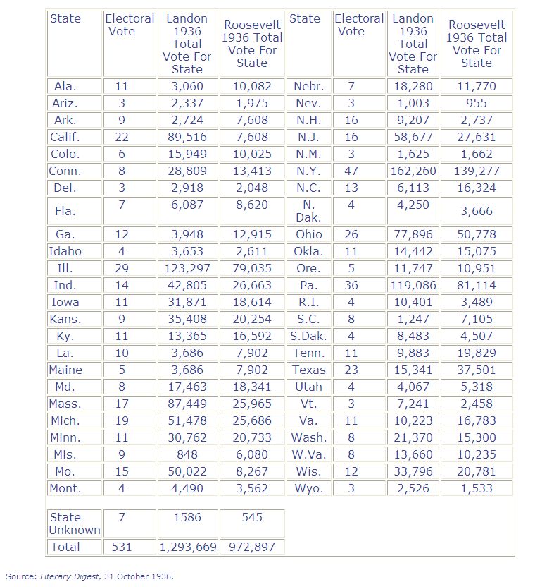
Election Polling
In 1936, Literary Digest ran their by then traditional presidential election poll of more than10 million Americans.
Similar polls they had run correctly predicted the outcome each time they had been conducted – 1916, 1920, 1924, 1928, and 1932.
Their results are displayed at right and effectively predict a landslide for the Republican candidate Alf Landon.
- 57% of the voters
- 370 Electoral College votes

Slide 9
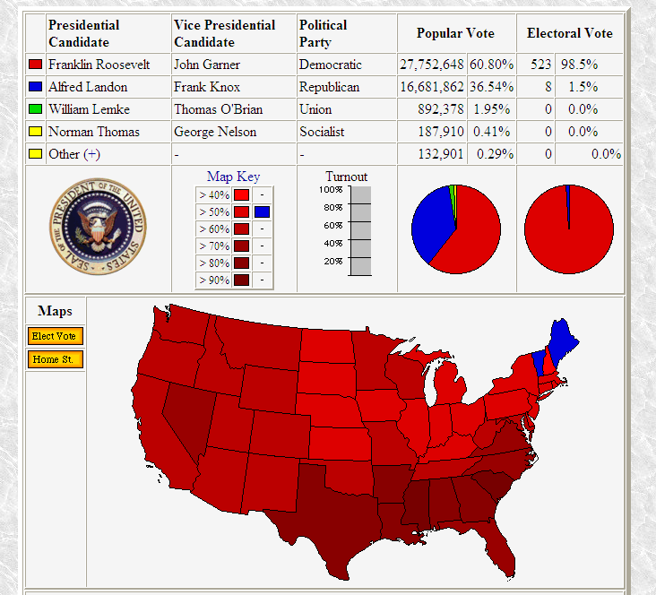
Election Polling
So what was the outcome?
Roosevelt won, but was it at least close?
- Well, no
Roosevelt won >60% of the vote and all but two states (ie, 523 of the 531 Electoral College votes)
So what happened?
Sample Bias Error
- Self-selected sample
- Bias in mailings
http://uselectionatlas.org/RESULTS/national.php?year=1936

Slide 10
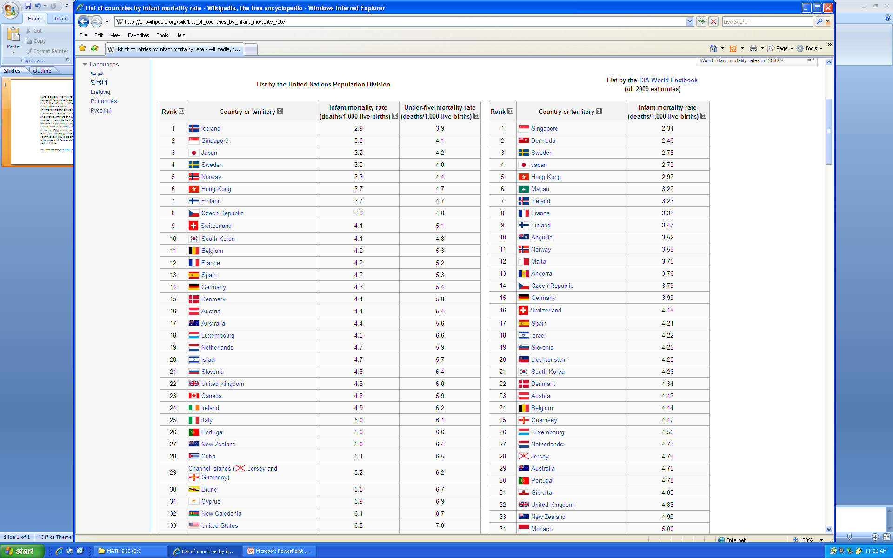
Infant Mortality Data
So where does the US rank among the most populous countries in the world in terms of Infant Mortality Rate (deaths/1000 live births)?
- Lowest Rate (Rank 1)
- Lowest Five (Ranks 2-5)
- Lowest Ten (Ranks 6-10)
- Outside Lowest Ten (Ranks > 10)
- Over/Under 20?
http://en.wikipedia.org/wiki/List_of_countries_by_infant_mortality_rate

Slide 11
Here's a general overview for you. When you compare infant mortality statistics you need to look for the definitions. What, for instance, constitutes a live birth? In the United States any infant exhibiting any sign of life is considered to be alive. It doesn't matter how small, how premature or how much it weights. In countries like France, the Netherlands and Ireland they don't count the birth as a live birth unless the infant weighs more than 500 grams or the mother was at least 22 [weeks] along in the pregnancy. Other countries won't count the birth as being a live birth unless the infant survives for a specified period of time.
http://boortz.com/nealz_nuze/2009/11/those-phony-infant-mortality-s.html
So measurement approach is relevant, and differences in approach (ie, Measurement Errors) will work to hide the actual information that is really of interest.
Measurement Errors
Measurement Accuracy = No Bias Errors = Well-Calibrated Device
Measurement Precision = Good Repeatability & Reproducibility
Virtually Always Present in Quantitative, Continuous Data – Gauge Studies
Can be Present in Survey Data – Same Question Phrased Slightly Differently

Slide 12
Signal + Noise Model
Observed
Data Value
Actual
Value
Measurement
Error
=
+
What we See, What is
“Revealed”, the “Lie”
What we Want to Know,
What is “Essential”
Nuisance, But Real
- Sampling Errors
- Bias Errors
- Measurement Approach
Variation Errors
- Blunders
The Basic Statistical Model reflected above is:
Y_{i} = μ + ε_{i}
Observed Data Value
Signal =
Parameter We Really Want to Know
Noise =
Errors due to Sampling, Bias, Measurement, Mistakes, etc.
How much of what is Observed is Signal and how much is Noise?

Slide 13
Probability and Statistics
- Probability attempts to evaluate the chance that specific events will occur
given knowledge of a Population
- Statistics attempts to evaluate what a Population looks like
given the occurrence of an event (ie, a Sample)
Population
Probability
Statistics
Sample

